Slide 1
Streamlining the computer test engineering room
By: Nam Vo

Slide 2
I. Introduction
One of the main projects, for my time within the engineering department, is to analyze the relationship between output and other factors that may influence output
Output: Relays
Quantifying this relationship though econometrics may be crucial to pinpointing bottlenecks in the current testing process
May also expose inefficient use of the current equipment
May save money in the long-run if the current obstacle is fixable

Slide 3
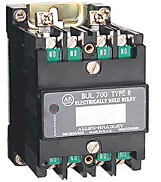

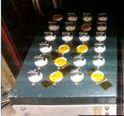
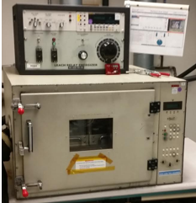

I. Introduction P.2
Output: Relays (electronic switches)
Factors that may affect output: Age of Chamber, Age of the test trays, operator experience, and amount of hours operator has worked thus far
Relay
Operator
Test Tray
Test Chamber
End Product is Shipped
The total time that relays take to finish is very inconsistent. Some batches take 2 hours to finish while some take 7 hours to finish

Slide 4
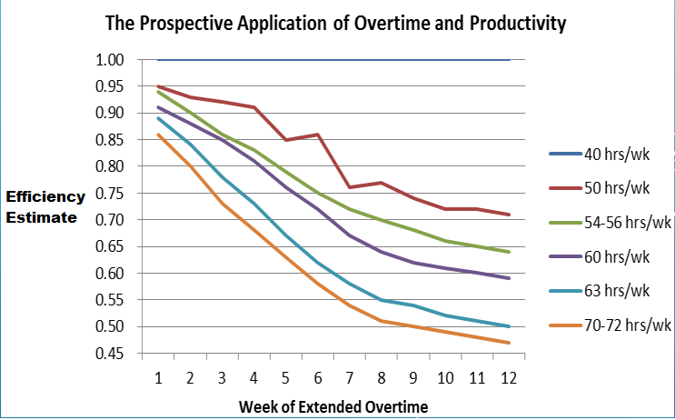
II. Literature review
My research question is very specific… so I had to review journals and articles relating to productivity over time and work experience
These articles prove insight regarding the operator’s productivity over the course of a work day
Studies in the labor market links increased inefficient use of time over the course of a workday as hours worked increases
Inefficiency is a measure of output vs time spent during overtime in this case study
There are further studies relating efficiency vs work experience
Hypothetically, workers are expected be more efficient as they gain more work experience
Nothing conclusive was found. Results fluctuate between industry types

Slide 5

III. Theoretical analysis
Dependent Variable: Total time to produce output (Y)
Independent Variables: Age of chambers (X1), age of test trays (X2), operator experience (X3), hours operator has worked thus far (X4)
Letters in operator’s name (X5) is added later to test for robustness
Theoretical model with hypothesized signs
$Time OUTPUTi=β_{0}+ β_{1}AgeOfCHMBRi+ β_{2}AgeOfTRAYi+/−β_{3}OpEXPi−β_{4}OpHrsWRKEDi$

Slide 6
IV. Empirical Analysis
Summary Statistics
Variable | Obs | Mean | Std. Dev | Min | Max
Total Time | 93 | 236.82 | 85.21 | 90 | 440
Age of CH | 93 | 7.22 | 3.63 | 4 | 15
Age of Tray | 93 | 7.17 | 4.77 | 1 | 15
Op EXP | 93 | 5.37 | 2.77 | 0 | 12
Op Hrs Wrked | 93 | 5.19 | 2.56 | 1 | 9

Slide 7
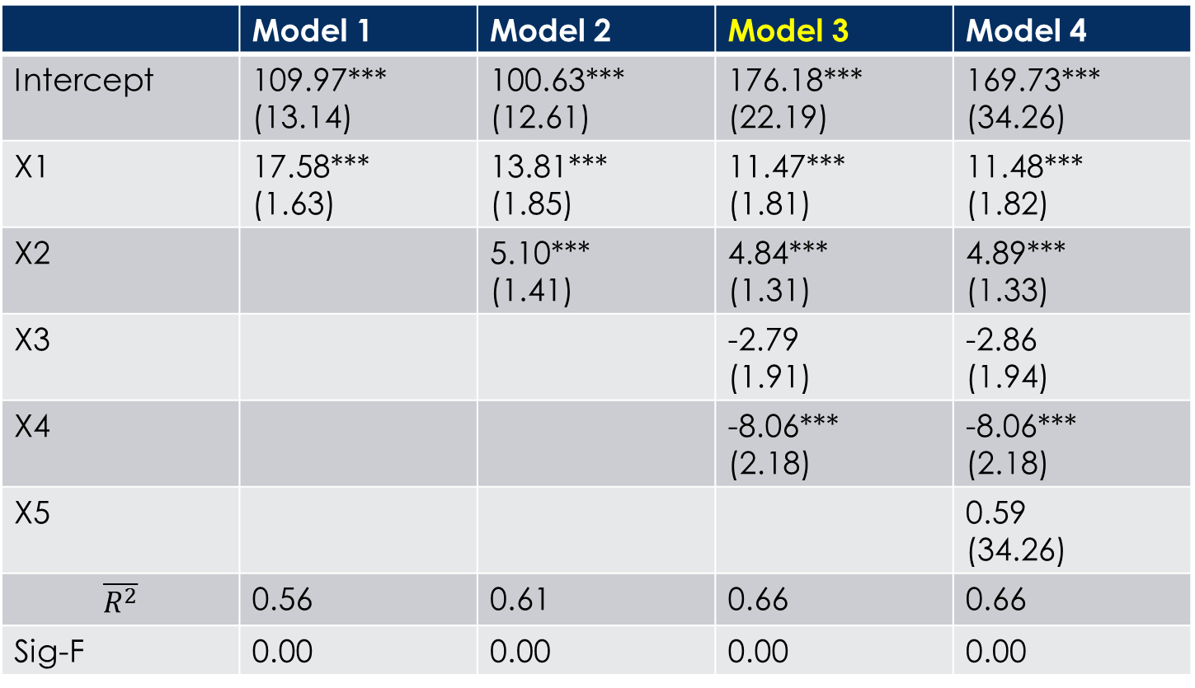
IV. Empirical Analysis P.2
Regression Output; n=93 for all parameters
 | Model 1 | Model 2 | Model 3 | Model 4
Intercept | 109.97*** (13.14) | 100.63*** (12.61) | 176.18*** (22.19) | 169.73*** (34.26)
X1 | 17.58*** (1.63) | 13.81*** (1.85) | 11.47*** (1.81) | 11.48*** (1.82)
X2 |  | 5.10*** (1.41) | 4.84*** (1.31) | 4.89*** (1.33)
X3 |  |  | -2.79 (1.91) | -2.86 (1.94)
X4 |  |  | -8.06*** (2.18) | -8.06*** (2.18)
X5 |  |  |  | 0.59 (34.26)
$$\overline{R^{2}}$$ | 0.56 | 0.61 | 0.66 | 0.66
Sig-F | 0.00 | 0.00 | 0.00 | 0.00
*Significant at 10%, **5%, ***1%
*X5 is added for sensitivity analysis; it is the # of letters in operator I’s name

Slide 8
V. Conclusion
For the most part, my model proves to be significant and robust to at 1% significance level
Correlations between output time and 3 parameters are significant and similar to my hypothesized model
Significance regarding the parameter on years of experience follows empirical studies (not conclusive)
To build upon my findings…
I might need to collect more data that may explain my dependent variable better such as: amounts of repairs on chambers & trays, hours of sleep each operator has, etc.
I would recommend measures to increase average output time such as: more frequent breaks for the operators & more funds allocated towards buying new chambers and trays

